Slide 1
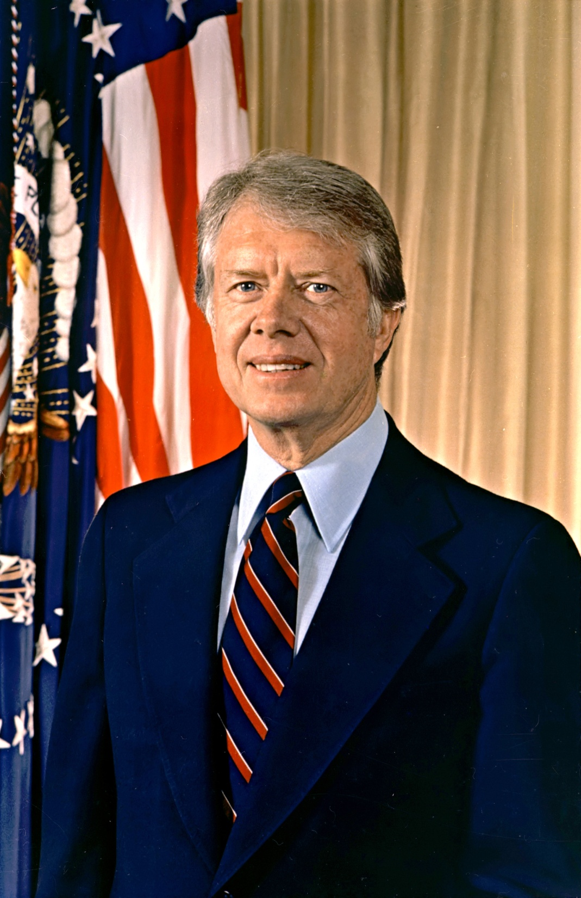
James Carter

Slide 2
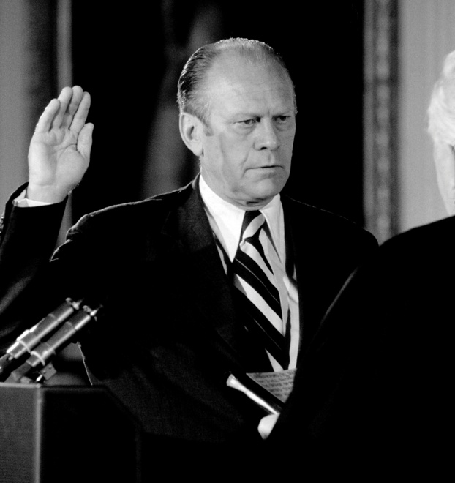
President Ford Faces Obstacles
Watergate Scandal created tension.
Pardon of Nixon was divisive
Many felt Nixon should go to prison
Economy facing growing inflation and
Unemployment. These factors led
to Ford’s defeat to a democrat,
Jimmy Carter, in the election of 1976

Slide 3
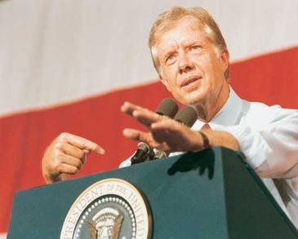
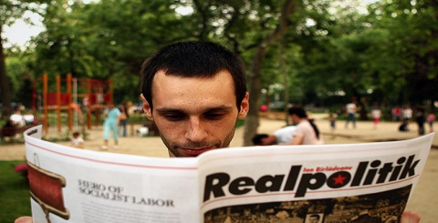
Human Rights and Realpolitik
Nixon and Ford entered into unprecedented relations with Communist nations
Carter took a different approach
Nixon and Ford- face reality China and Russia too influential to ignore
Realpolitik- dialogue with Communist nations
Carter had a different approach. He only wanted to cooperate with nations that would protect Human Rights, such as the freedoms of religion, speech, the right to petition, and so on.

Slide 4
Dictatorships and Human Rights
Cold War- U.S. supported various nations that had dictatorships- Nicaragua and other Latin American countries
The reason that the U.S.A. supported these countries was that while they were dictatorships, they opposed Communism and were viewed as Allies in the Cold War against the USSR

Slide 5
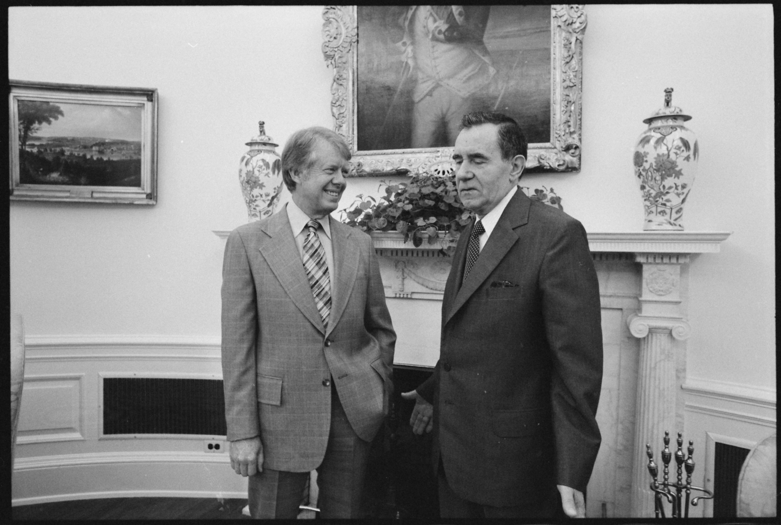
Carter’s Human Rights Approach Faces Criticism
Many respected goal- see other nations pursue human rights
Many felt policy was naive and unrealistic
These critics felt that Carter had to work with oppressive nations, such as Nicaragua, to ensure that these nations did not fall to Communism
USSR denied many citizens Human Rights and Carter reduced cooperation with the Soviet Union.
Many felt this would escalate Cold War hostilities again
Wanted Carter to cooperate more with Soviet Union

Slide 6
Carter and the struggling economy
The USA had become radically dependent on foreign oil and Carter asserted this contributed to the bad economy. He claimed the USA must reduce its dependence on foreign oil.
Pursued energy saving measures- gas guzzlers, alternative power
OPEC increased oil prices again.
Inflation increased
Economy grew worse

Slide 7
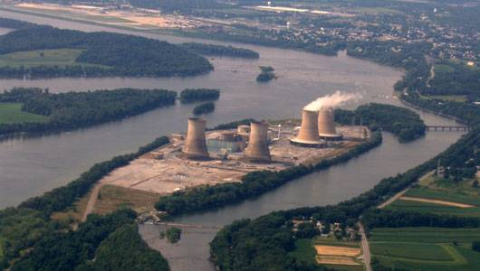
Three Mile Island
In 1979 at Three Mile Island nuclear power plant in Harrisburg, PA, a cooling malfunction caused part of the core to melt in the #2 reactor. The TMI-2 reactor was destroyed.
Some radioactive gas was released a couple of days after the accident, but not enough to cause any dose above background levels to local residents.
There were no injuries or adverse health effects from the Three Mile Island accident.

Slide 8
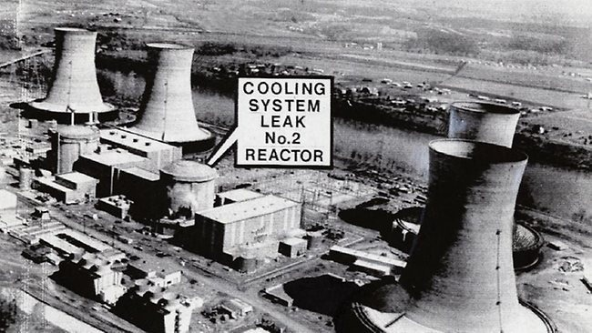
Three Mile Island: Public Concern and Confusion
When the accident is recalled, it is often in the context of what happened on Friday and Saturday, March 30-31.
The drama of the accident-induced fear, stress and confusion on those two days.
Public began to distrust
nuclear power

Slide 9
Israel vs. Egypt
Religious tensions between Jews and Muslims
Disputed fights over land
On May 14, 1948, David Ben-Gurion, the head of the Jewish Agency, proclaimed the establishment of the State of Israel. U.S. President Harry S. Truman recognized the new nation on the same day.

Slide 10
Creation of Israel
-area in the Middle East between the Jordan River and the Mediterranean Sea
absorbed into the Ottoman Empire in 1517; remained under the rule of the Turks until World War One
peace talks parts of Ottoman Empire given to French and British
Britain governed area under League of Nations mandate from 1920 to 1948
McMahon Agreement- Arabs believed this promised area to them
Balfour Declaration- Jews believed this promised area to them
Arabs and Jews appeared to live together -that tolerated existence of the other
United Nations- 1947 accepted the idea to partition Palestine into a zone for the Jews (Israel) and a zone for the Arabs (Palestine).
British withdrew from the region on May 14th 1948

Slide 11
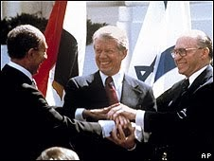
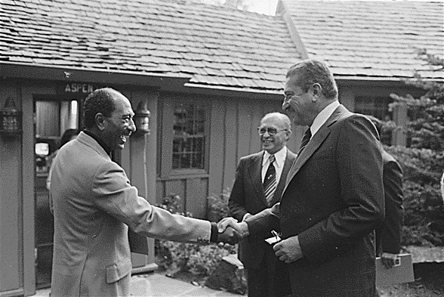
Camp David Accords
At the Camp David Accords, in 1978, Carter persuaded the President of Egypt, Anwar El Sadat and the Israeli Prime minister, Menachem Begin, to sign a peace treaty and cease fighting. This was a major victory for Carter
Israel gave land back to Egypt
Egypt was first Muslim Country to recognize Israel as a nation

Slide 12
Awarded the Nobel Peace Prize

Slide 13
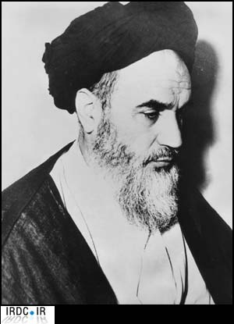
Iran Hostage Crisis
Iran ally of U.S.
Supported West during Cold War
Shah of Iran- Mohammad Reza Pahlavi
1979, extremist Shi’ite Muslims, led by Ayatollah Ruholla Mostafavi Moosavi Khomeini took over Iran and implemented a theocracy based on their interpretation of Islam

Slide 14
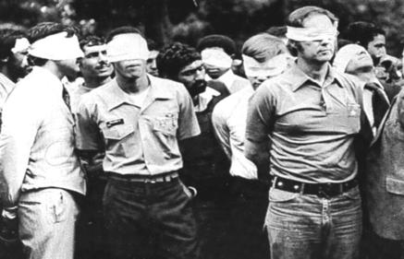
Iran Hostage Crisis
American hostages taken at U.S. embassy in Tehran
Held by extremists for 444 days
Carter could not secure their release

Slide 15
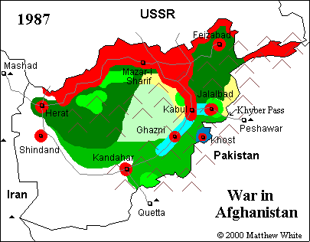
USSR’s War in Afghanistan
Mujahedeen- loosely connected rebel Muslim groups in Afghanistan
Jihad- Holy War against Communists, Soviet influence
Foreigners also arrived to fight in Afghanistan against the USSR. Notorious among them was a Saudi named Osama bin Laden, whose group
eventually evolved into Al-Qaeda, the
group who attacked on 9/11.

Slide 16
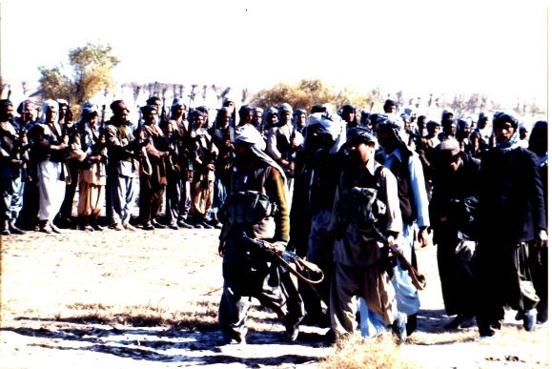
War in Afghanistan
USA gave aid to rebels in Afghanistan
Cold War versus theocracy of Muslim extremists

